Slide 1
The Announcement Layer: Beacon Coordination for the Sensornet Stack
Adam Dunkels, Luca Mottola, Nicolas Tsiftes,
Fredrik Österlind, Joakim Eriksson, Niclas Finne
adam@sics.se
Swedish Institute of Computer Science (SICS)

Slide 2
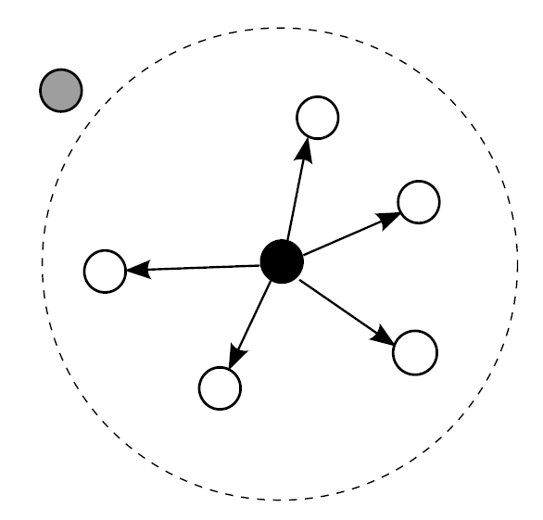
The Message
Broadcast is expensive
Control traffic expensive
Trend: protocol concurrency
An announcement layer
Beacon coordination
Push and pull operations
Reduced control traffic cost for concurrent protocols
Reduced power consumption
Data Collection
Data Dissemination
Neighbor Discovery
Announcements
Medium Access Control
Radio Duty Cycling
Radio

Slide 3
Why should we care?
Radio duty cycle (%)
2
1.5
Data collection
1
Data dissemination
0.5
Data collection
Data collection
Data collection
0
Control traffic: Beacons
Data

Slide 4
Broadcast

Slide 5
Wireless Broadcast

Slide 6
Duty Cycling, Asynchronous
Sleeping
Active

Slide 7
Broadcast gets expensive – Asynchronous Duty Cycling
Sleeping
Active

Slide 8
Broadcast is still expensive – Synchronous Broadcast Slot
Sleeping
Active

Slide 9
Just how expensive is broadcast?
Radio duty cycle (%)
Broadcast
Unicast
40
30
20
10
0
1
2
3
4
5
6
7
8
Transmissions per second

Slide 10
Why broadcast?

Slide 11
Why Broadcasts?
Control traffic in network, transport, application layer protocols
Periodic beacons
Discovery beacons
Presence beacons
Routing beacons
Meta data beacons
Data
Low-level protocols
Time synchronization, duty cycling, …

Slide 12
Control Traffic: Periodic Beacons, Push & Pull
Periodic beacons
Randomized to avoid synchronization
Push and pull
Pull – request data from neighbors
CTP, Contiki collect: loop detected
Trickle: boot up
Push – transmit data to neighbors
CTP, RPL, Contiki collect: improved route found
Trickle: new version

Slide 13
Reducing broadcasts
Adaptive beaconing
CTP [Gnawali et al. SenSys 2009]
Beacon suppression
Trickle [Levis et al. NSDI 2004]
RPL [IETF ROLL 2011]
Rethinking broadcast
Politecast [Lundén, Dunkels ACM CCR 2011]

Slide 14
An Announcement layer

Slide 15
Data Collection
Data Dissemination
Neighbor Discovery
Medium Access Control
Radio Duty Cycling
Radio

Slide 16
Data Collection
Data Dissemination
Neighbor Discovery
Announcements
Medium Access Control
Radio Duty Cycling
Radio

Slide 17
Announcement Layer
Beacon Coordination
Piggyback multiple beacons in each transmission
One transmission within each beacon interval
Push and pull operations

Slide 18
Announcement Layer API
An announcement is a (key, value, rate) tuple
API
register(key)
setValue(key, value)
setMinRate(key, rate)
push(key)
pull(key)

Slide 19
Beacon Coordination
Time
App 1
App 2
No
Coordination
With
Coordination

Slide 20
Push and Pull
Push
Transmit registered beacons
Pull
Ask for registered beacons from neighbors
Push and pull needs only be done once, for all announcements

Slide 21
Evaluation

Slide 22
Microbenchmark: Beacon Transmissions
Transmissions / second
Without coordination
With coordination
10
8
6
4
2
0
1
2
3
4
5
6
7
8
Registered announcements

Slide 23
Microbenchmark: Power Consumption
Radio duty cycle (%)
Without coordination
With coordination
10
8
Not horizontal
6
4
2
0
1
2
3
4
5
6
7
8
Registered announcements

Slide 24
Contiki shell: collect + trickle
Duty cycle (%)
No coordination
With coordination
1.5
The difference is (almost)
equal to the cost of trickle
1
0.5
Beacons
Data

Slide 25
Drawbacks?

Slide 26
Potential drawbacks
Code size overhead?
Less code needed for each protocol implementation
Are protocols affected?
What about unbalanced announcements?

Slide 27
Are Protocols Affected?
What if a protocol expects a beacon, but the beacon is cancelled?
Beacon is cancelled because already transmitted
No visible effect for the protocol
Protocol concurrency affects protocols though
Announcements for periodic, randomized beacons
Otherwise, use direct broadcast

Slide 28
Unbalanced Beacons
Two beacons:
One small and fast
One large and slow
Always piggybacking will increase power consumption
This is a real problem
But only in our current implementation
Having a beacon layer allows us to solve it
Improved beacon coordination algorithm
Hysteresis for when to piggyback

Slide 29
COnclusions

Slide 30
Conclusions
Control traffic is expensive, concurrent protocols make it worse
Because broadcast is expensive
Announcement layer
Beacon coordination
Push and pull
To be included in Contiki 2.5+
Beacon coordination reduces the power consumption of concurrent control traffic

Slide 31
Thank you!
Questions?

